Slide 1
Spring
Learning Spring Programming

Slide 2

About this Course

Slide 3
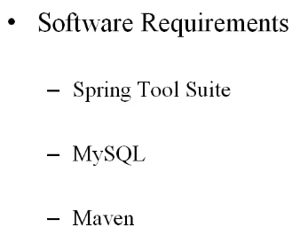
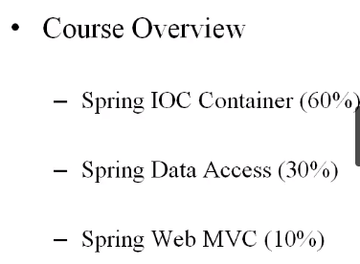

Slide 4


Slide 5

Download the Spring Tool Suite

Slide 6

Download the Working files
Notes:
http://shop.oreilly.com/product/0636920035985.do

Slide 7
Spring Inversion of Control

Slide 8


Slide 9
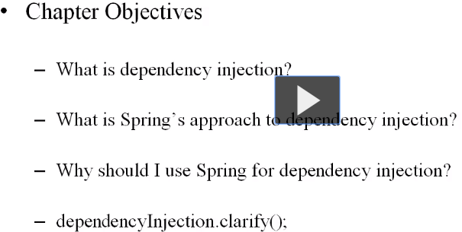
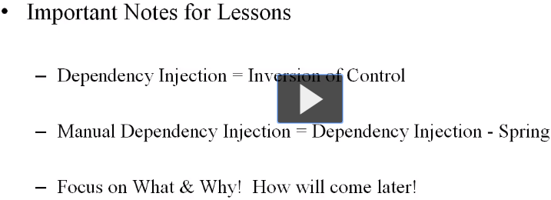

Slide 10
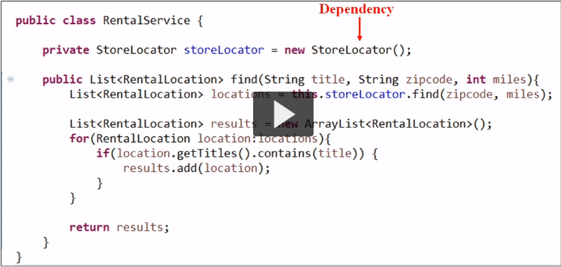
Dependency Injection Overview

Slide 11
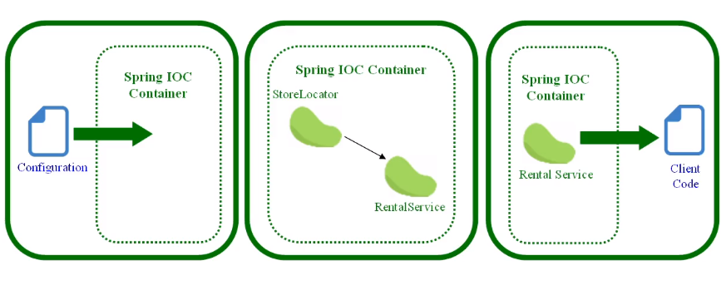
http://martinfowler.com/articles/injection.html

Slide 12
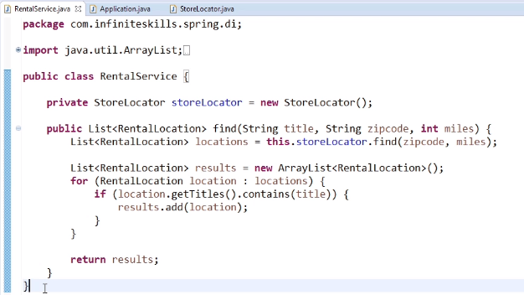
Dependency Injection In Practice

Slide 13
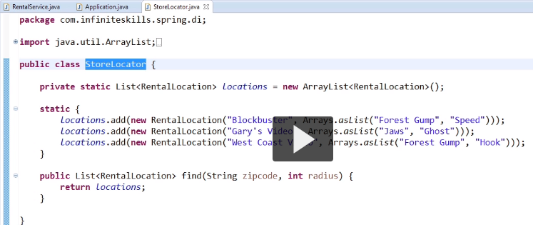

Slide 14
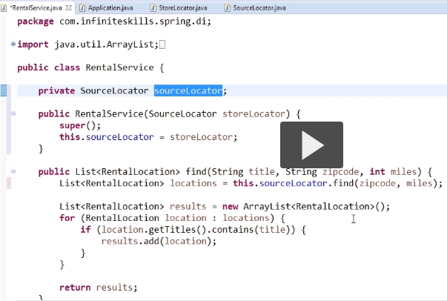

Slide 15
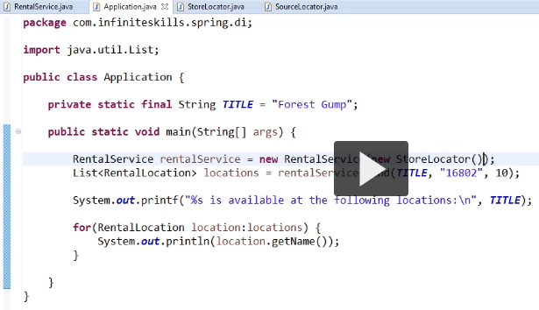

Slide 16
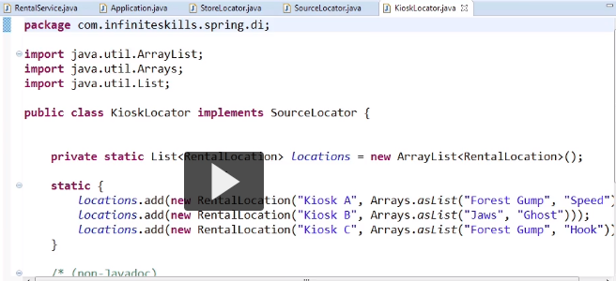

Slide 17
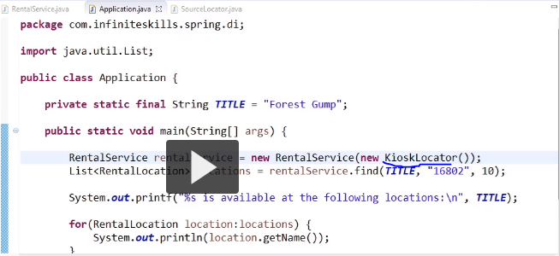

Slide 18
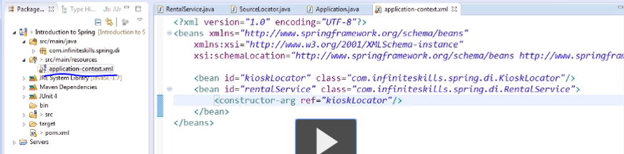
IOC Container

Slide 19
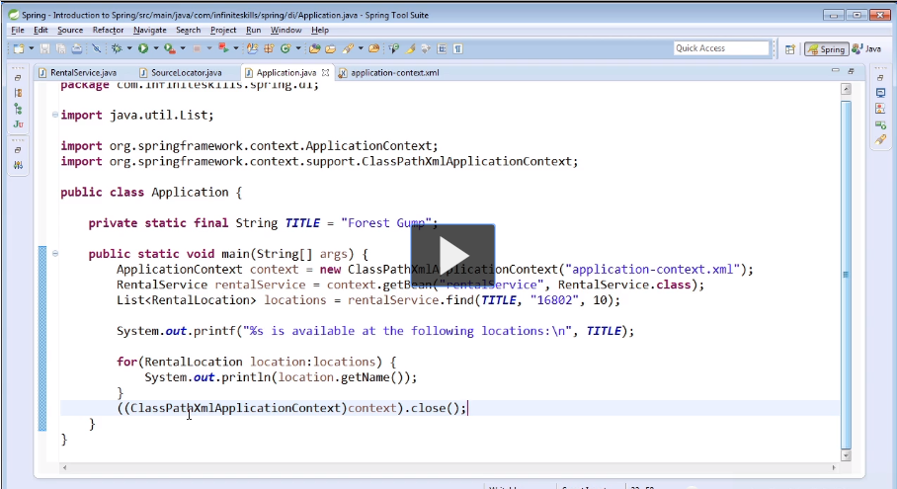

Slide 20
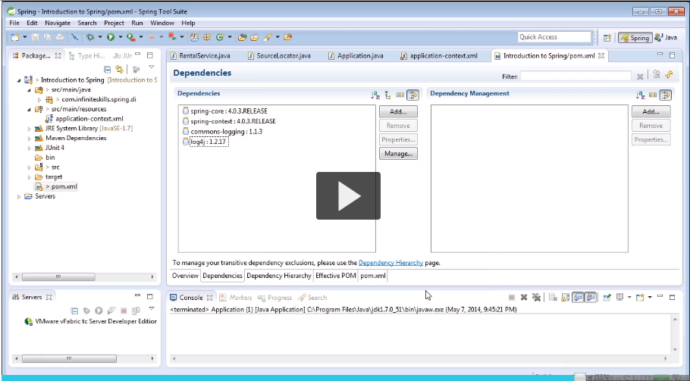

Slide 21
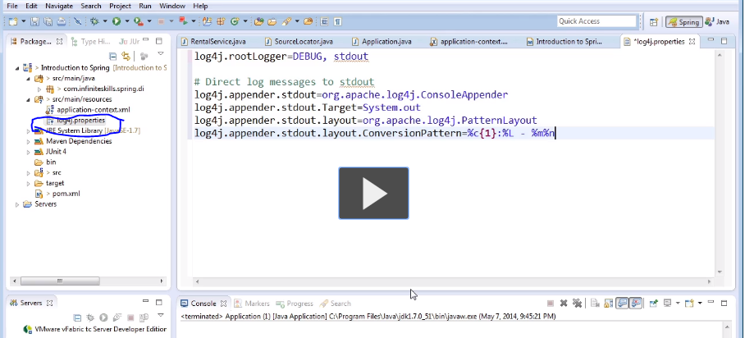

Slide 22
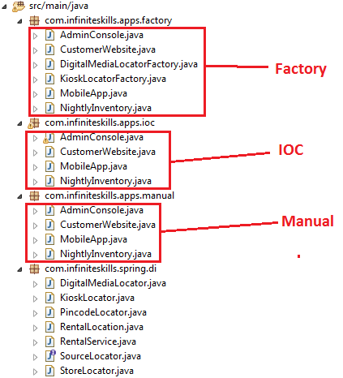
Spring IOC Container Benefits - Part 1

Slide 23
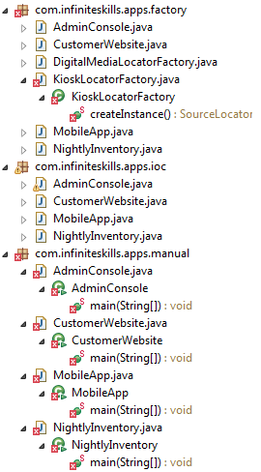
Change in Constructor of KisokLocator will bring in errors in all class using it, as shown below :
So we can see when there is a change in dependencies,
We can see that Spring IOC container seems to handle that change lot better because they centralize the construction of objects at used in our application.
But manual dependency injection is involved decentralized dependency injection.

Slide 24
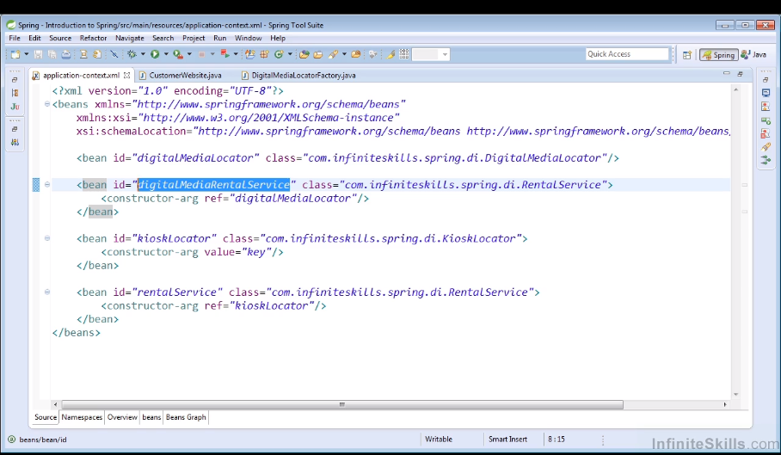
Spring IOC Container Benefits - Part 2

Slide 25
Spring Beans

Slide 26

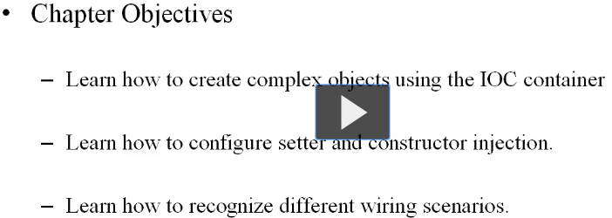
Spring Beans Overview

Slide 27


Slide 28
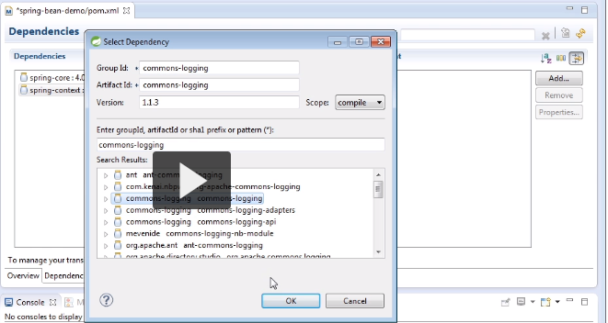
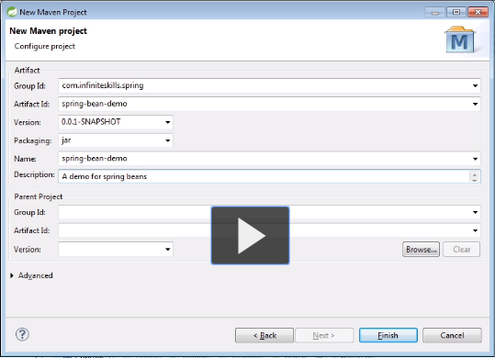
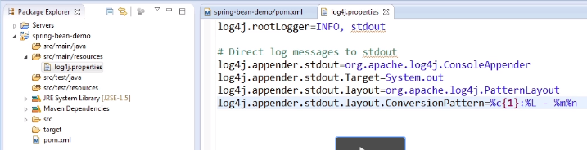
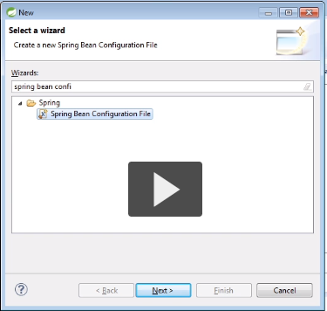
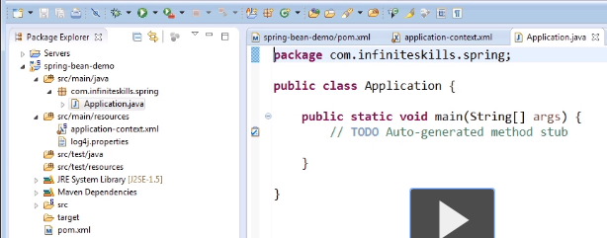
Base Project Setup

Slide 29
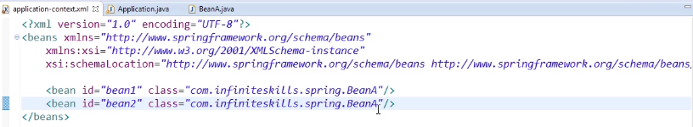
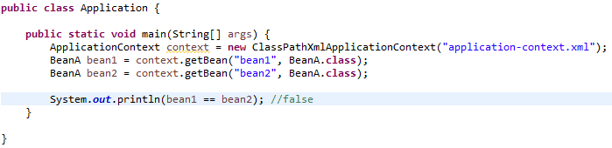
Introduction To Beans

Slide 30
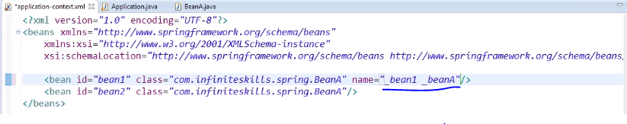
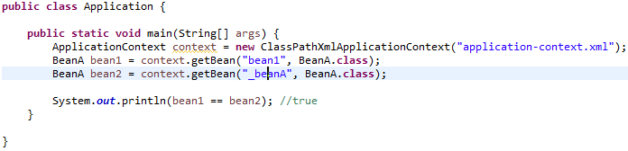
We can specify multiple names for bean

Slide 31
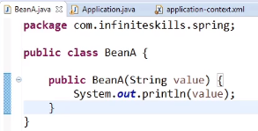
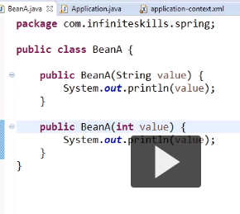
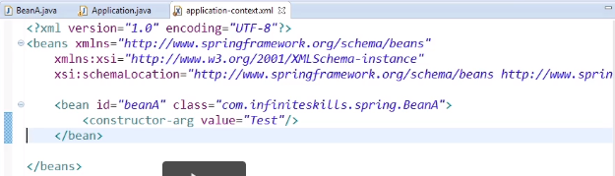
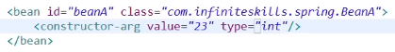
Constructor Injection - Part 1

Slide 32
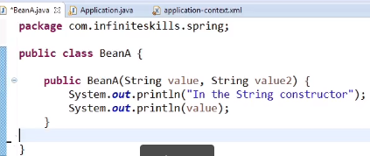
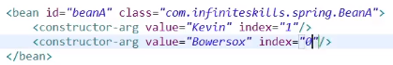

Slide 33
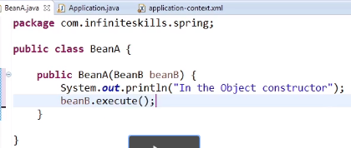
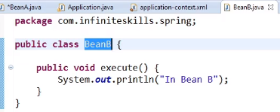
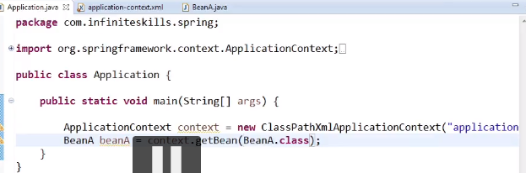
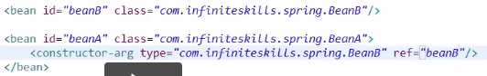
Constructor Injection - Part 2

Slide 34
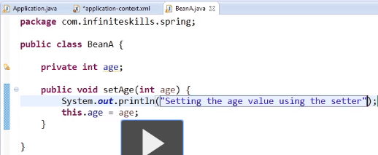
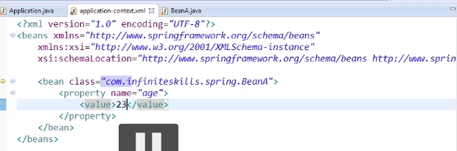
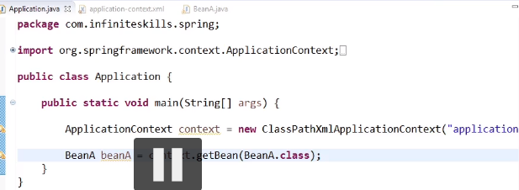
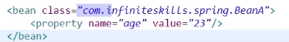
Setter Injection

Slide 35
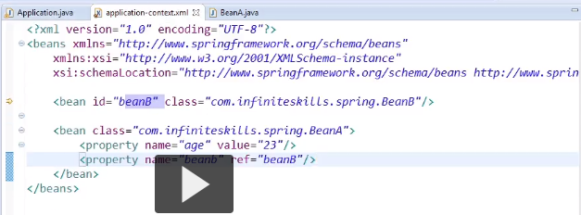
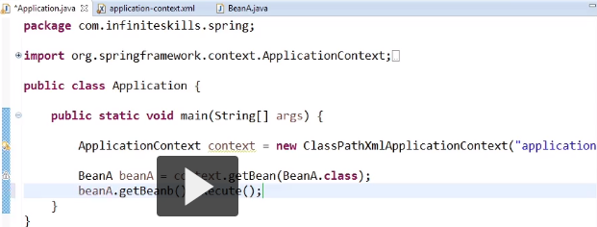

Slide 36
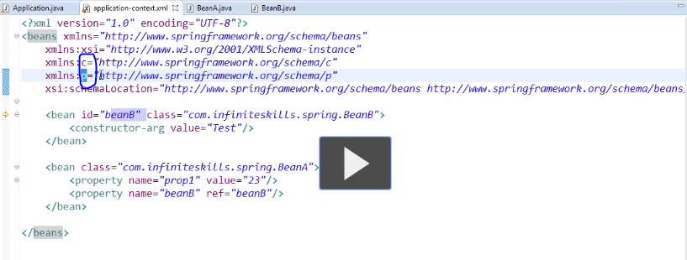
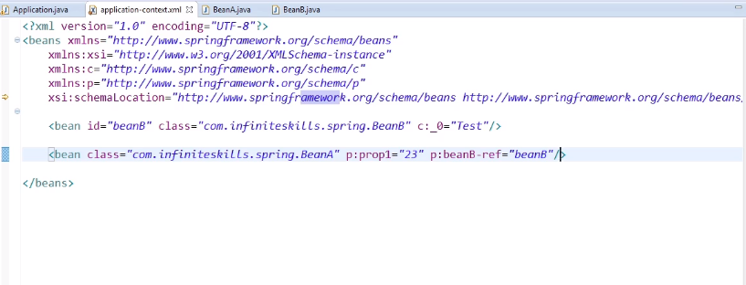
P Namespace And C Namespace

Slide 37
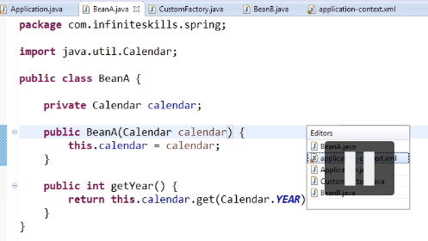
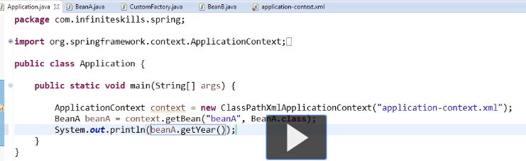
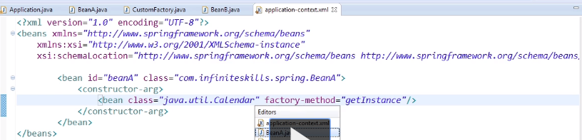

Bean Instantiation With Factories

Slide 38




Slide 39


Bean Scopes

Slide 40



Method Injection And Application Context Aware
What happens when a bean of Prototype Scope interacts with bean of Singleton scope.

Slide 41


Implementation of Application Content Aware

Slide 42



Implementation of Method Injection

Slide 43


Collections
Notes:
public class Bean{
private List<String> list;
private Map<String, String> map;
private Set<String> set;
private Properties property;
// getter & setter methods
}
<bean id=“bean” class=“com.infiniteskills.spring.Bean”>
<property name=“list”>
<list>
<value><value>
<value><value>
</list>
</property>
<property name=“set”>
<set></set>
</property>
<property name=“map”>
<map>
<entry key=“a” value=“Apple”/>
<entry key=“b” value=“Ball”/>
<entry key=“c” value=“Cake”/>
</map>
</property>
<property name=“properties”>
<props>
<prop key=“a”>Apple</prop>
<prop key=“b”>Ball</prop>
</props>
</property>
</bean>

Slide 44

Collections

Slide 45

Auto-Wiring with XML Part-1 & 2
Notes:
Auto Wiring is used heavily in Spring, This is an important concept
When we use Auto Wiring Spring will inject automatically dependencies to our beans. There is no need of XML.

Slide 46

Auto-Wiring with XML Part-1 & 2(cont..)
Notes:
When IOC container starts it’s going to create beans that don’t have any dependency i.e., BeanC, BeanD twice and BeanB
And now it’s going to start creation of BeanA, it’s going to look at all constructors and pick the one which has most arguments that it can satisfies.
If we change the autowire of BeanB from byName to byType, below exception is reported :
Caused by: org.springframework.beans.factory.NoUniqueBeanDefinitionException: No qualifying bean of type [com.infiniteskills.spring.BeanD] is defined: expected single matching bean but found 2: beanD,beanD2

Slide 47

Auto-Wiring with XML Part-1 & 2(cont..)

Slide 48

Auto-Wiring with XML Part-1 & 2(cont..)

Slide 49

Auto-Wiring with XML Part-1 & 2(cont..)

Slide 50

Auto-Wiring with XML Part-1 & 2(cont..)

Slide 51


Auto-Wiring with XML Part-1 & 2(cont…)

Slide 52
Attribute : autowire
Controls whether bean properties are "autowired".
This is an automagical process in which bean references don't need to be coded explicitly in the XML bean definition file, but rather the Spring container works out dependencies.
The effective default is "no“, There are 4 modes:
1. "no" The traditional Spring default. No automagical wiring. Bean references must be defined in the XML file via the <ref/> element (or "ref" attribute). We recommend this in most cases as it makes documentation more explicit. Note that this default mode also allows for annotation-driven autowiring, if activated. "no" refers to externally driven autowiring only, not affecting any autowiring demands that the bean class itself expresses.
Notes:
Data Type : string
Default Value : default
Enumerated Values :
- default
- no
- byName
- byType
- constructor

Slide 53
2. "byName" Autowiring by property name. If a bean of class Cat exposes a "dog" property, Spring will try to set this to the value of the bean "dog" in the current container. If there is no matching bean by name, nothing special happens.
3. "byType" Autowiring if there is exactly one bean of the property type in the container. If there is more than one, a fatal error is raised, and you cannot use byType autowiring for that bean. If there is none, nothing special happens.
4. "constructor" Analogous to "byType" for constructor arguments. If there is not exactly one bean of the constructor argument type in the bean factory, a fatal error is raised. Note that explicit dependencies, i.e. "property" and "constructor-arg" elements, always override autowiring.
Note: This attribute will not be inherited by child bean definitions. Hence, it needs to be specified per concrete bean definition. It can be shared through the 'default-autowire' attribute at the 'beans' level and potentially inherited from outer 'beans' defaults in case of nested 'beans' sections (e.g. with different profiles).

Slide 54
Configuring The IOC Container With Annotations
Wiring Beans Together with Annotations

Slide 55


Overview
Notes:
Annotations is about using another form of META Data to configure the Spring IOC container, So that we can use Dependency Injection.
Common Approach :
Always use bean definitions for the 3rd Party Classes like Hibernate EntityManager.
And use annotation for beans you declare in applications.

Slide 56

What is Annotation Configuration?

Slide 57

Introduction to Annotation Configuration
In this lesson, We were able to use Annotation to inject some configuration into our Beans.
On specifying <context:annotation-config> in xml, we can enable Autowiring using Annotations.

Slide 58


Slide 59


Slide 60
Output of earlier application :

Slide 61

Auto-Wiring with Annotation Part-1 Setter Injection using Annotation

Slide 62


Auto-Wiring with Annotation Part-1 Setter Injection using Annotation
Notes:
If BeanD did not exists in our IOC container, we will not get any error. And container is not satisfy our

Slide 63

Auto-Wiring with Annotation Part-1 Constructor Injection using Annotation
Constructor Injection using Annotations

Slide 64

Auto-Wiring with Annotation Part-1 Setter Injection using Annotation

Slide 65

Auto-Wiring with Annotation Part-1 Setter Injection using Annotation(Output)

Slide 66



Auto-Wiring with Annotation Part-2 Auto-Wiring for Arrays, List, Map, Set…
Basic setup before modification.

Slide 67


Slide 68



Auto-Wiring with Annotation Part-2 Auto-Wiring for Arrays

Slide 69

Auto-Wiring with Annotation Part-2 Auto-Wiring for List

Slide 70



Auto-Wiring with Annotation Part-2 Auto-Wiring for Map
Notes:
for(Entry<String,BeanB> entry: beanA.getBeanBs.entrySet()){
System.out.println(entry.getKey() + “” entry.getValue());
}

Slide 71

Auto-Wiring with Annotation Part-2 Using ApplicationContext in Auto-Wiring
AutoWiring is always performed by Type.

Slide 72
org.springframework.beans.factory.annotation Annotation Type Autowired
@Target(value={CONSTRUCTOR,FIELD,METHOD,ANNOTATION_TYPE}) @Retention(value=RUNTIME) @Documented
public @interface Autowired Marks a constructor, field, setter method or config method as to be autowired by Spring's dependency injection facilities. Only one constructor (at max) of any given bean class may carry this annotation, indicating the constructor to autowire when used as a Spring bean. Such a constructor does not have to be public.
Fields are injected right after construction of a bean, before any config methods are invoked. Such a config field does not have to be public.
Config methods may have an arbitrary name and any number of arguments; each of those arguments will be autowired with a matching bean in the Spring container. Bean property setter methods are effectively just a special case of such a general config method. Such config methods do not have to be public.
In the case of multiple argument methods, the 'required' parameter is applicable for all arguments.

Slide 73
In case of a Collection or Map dependency type, the container will autowire all beans matching the declared value type. In case of a Map, the keys must be declared as type String and will be resolved to the corresponding bean names.
Note that actual injection is performed through a BeanPostProcessor which in turn means that you cannot use @Autowired to inject references into BeanPostProcessor or BeanFactoryPostProcessor types. Please consult the javadoc for the AutowiredAnnotationBeanPostProcessor class (which, by default, checks for the presence of this annotation).

Slide 74

@Qualifier Annotation
There may be a situation when you create more than one bean of the same type and want to wire only one of them with a property,
in such case you can use @Qualifier annotation along with @Autowired to remove the confusion by specifying which exact bean will be wired.
NoUniqueBeanDefinitionException will be reported if we don’t use @Qualifier annotation.

Slide 75

@Qualifier Annotation(cont..)

Slide 76

@Qualifier Annotation(cont..)

Slide 77


@Qualifier Annotation(cont..)

Slide 78

@Qualifier Annotation(cont..)

Slide 79

How to create Custom Qualifier

Slide 80

java.lang.annotation Annotation Type Target

Slide 81


Slide 82


@Resource Annotation
Notes:
@Resource annotation is auto-wire byName.
@Autowired annotation is auto-wire byType.

Slide 83



@Resource Annotation

Slide 84



Slide 85
javax.annotation Annotation Type Resource
@Target(value={TYPE,FIELD,METHOD})
@Retention(value=RUNTIME)
public @interface Resource
The Resource annotation marks a resource that is needed by the application. This annotation may be applied to an application component class, or to fields or methods of the component class. When the annotation is applied to a field or method, the container will inject an instance of the requested resource into the application component when the component is initialized. If the annotation is applied to the component class, the annotation declares a resource that the application will look up at runtime.
Even though this annotation is not marked Inherited, deployment tools are required to examine all superclasses of any component class to discover all uses of this annotation in all superclasses. All such annotation instances specify resources that are needed by the application component. Note that this annotation may appear on private fields and methods of superclasses; the container is required to perform injection in these cases as well.

Slide 86

@Resource Annotation

Slide 87

@Component Scanning
Component Scanning and Annotation used have below limitation :
Using xml we can create as many instances of a particular bean as we need, but using above we can create only one bean per type.

Slide 88

@Component Scanning
@Component annotation

Slide 89


@Component Scanning
@Service annotation @Repository annotation

Slide 90

@Component Scanning

Slide 91

What's the difference between @Component, @Repository & @Service annotations in Spring?

Slide 92


Slide 93
@Lazy annotation
By default our bean gets instantiated as soon as the IOC container is created, by the lazy annotation allows us to delay the instantiated process.
It is class level annotation.

Slide 94


@Lazy annotation

Slide 95


@Lazy annotation

Slide 96

@Qualifier annotation

Slide 97


@Qualifier annotation

Slide 98

@Qualifier annotation

Slide 99

@Scope annotation

Slide 100


@Scope annotation

Slide 101

@Scope annotation

Slide 102
Java Configuration Overview
Java Based Configuration : Another method of configuring the Spring IOC Container

Slide 103



Slide 104
Introduction to Java Configuration

Slide 105
Injecting Dependencies Part-1

Slide 106
Injecting Dependencies Part-2

Slide 107
Mixing Configuration Types

Slide 108
Additional Container Features

Slide 109
Additional Container Overview

Slide 110
Resolving Resources Part-1

Slide 111
Resolving Resources Part-2

Slide 112
Property Placeholder Configure

Slide 113
Using Imports To Organize Configuration

Slide 114
Bean Lifecycle Callbacks – Part1

Slide 115
Bean Lifecycle Callbacks – Part2

Slide 116
Profiles

